Slide 1
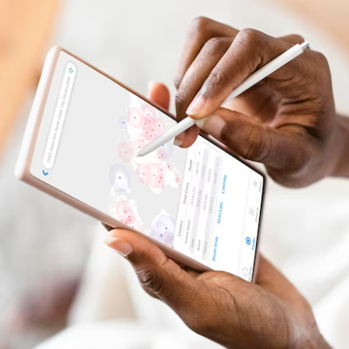
DATA COLLECTION INSTRUCTIONS USING CAPI
NPHC 2024 TRAINING

Slide 2
CAPI SYSTEM COMPONENTS
Field Data Management applications
Menu Controlling tasks for interviewers | Menu controlling tasks for supervisors
Data Collection applications
Household questionnaire
Community questionnaire
Institution questionnaire
Accommodation questionnaire
Floating questionnaire
Central Office System
Receive data from field
Check data consistency
Generate data
Quality analysis
Dashboard for monitoring

Slide 3
Key features of the CAPI interview System
Access to user Manuals
Data Capture screen
Tool bar
CAPI system buttons/icons
Different types of questions
Error messages
Changing interview language
Taking Notes
Partial Save

Slide 4
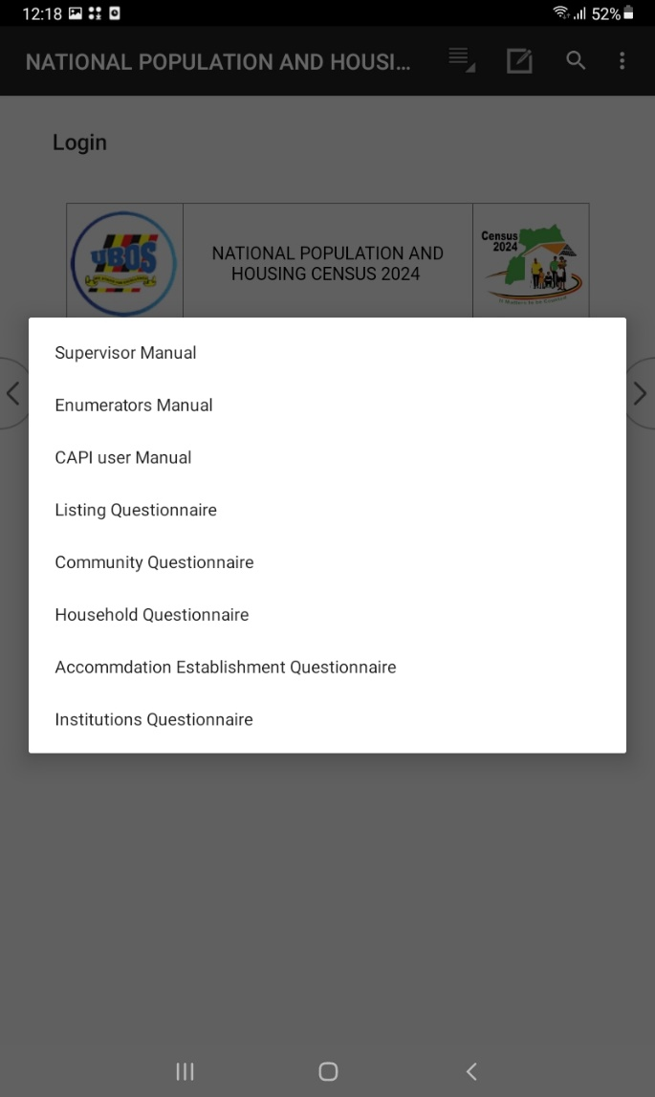
Access to User manuals
Tap the first icon (five lines), to view user manuals.
Select manual of your choice

Slide 5
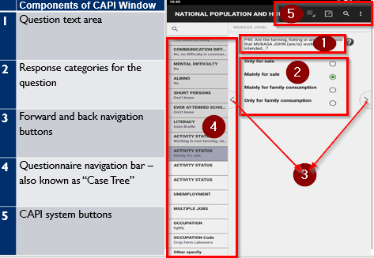
Data Capture Screen (1/2)
Notes:
1 - CAPI defined Buttons 2 - Area for questions 3 - Data capture controls
4 - Fields definition area 5 - Error messages 6 - CSPro status bar information

Slide 6
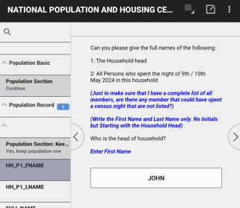
Data Capture Screen (2/2)
Questions and instructions
Black – read out loud respondent
BLUE – instructions for interviewer
Field for data entry

Slide 7
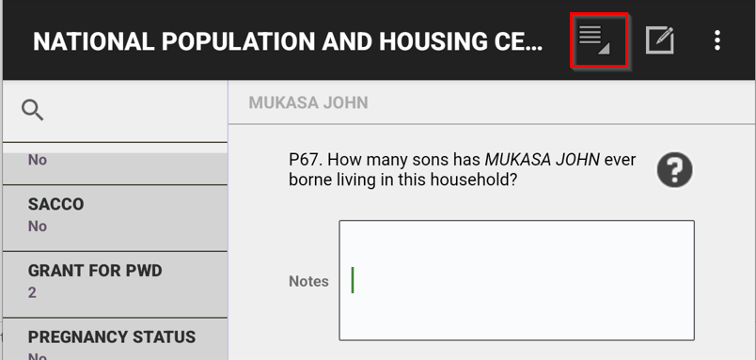
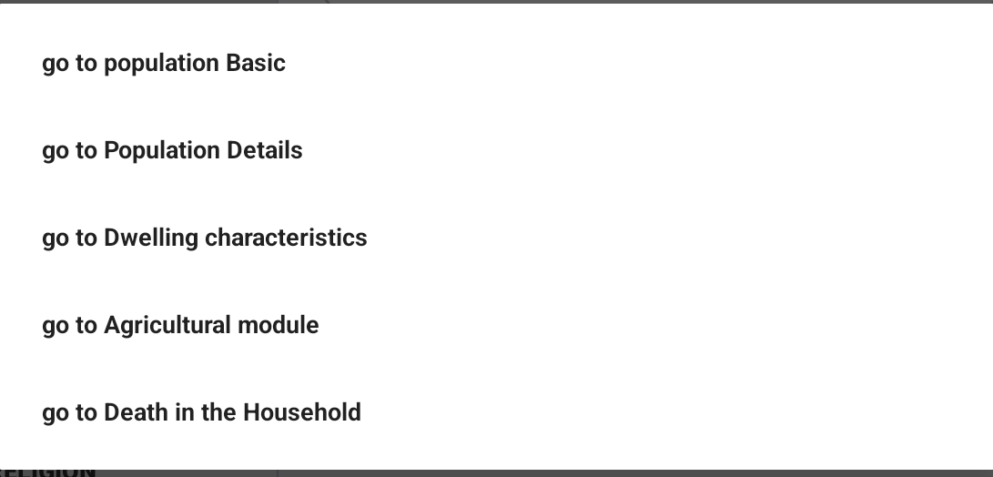
Toolbar - Household

Slide 8
Different types of Questions(1/4)
Radio buttons for single response questions
Check boxes for multiple response questions
Check boxes for multiple response questions with a limit
Open ended numeric responses
Open ended text responses
Questions with major group headings
Pre-filled “protected field” questions

Slide 9
Different types of Questions (2/4)
Single response
Multiple response

Slide 10
Different types of Questions (3/4)
Multiple choice with limit
Open ended numeric

Slide 11
Different types of Questions (4/4)
Open ended text response

Slide 12
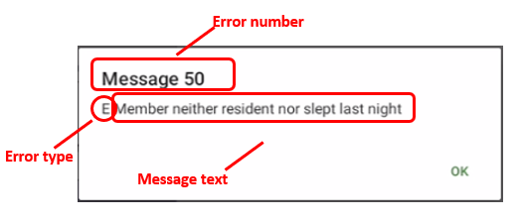
Error/Warning Messages: Structure of message
Message type –
- Warning : may continue without resolving it
- Error: must resolve to continue
Identifying number – use to identify issue and refer to instructions
Message text: describes issue causing message
Notes:
E-error type: Error is critical to the data integrity and as result it need to be corrected
W-error type: Error is not critical to the data integrity, but needs absolute attention before dismissing

Slide 13
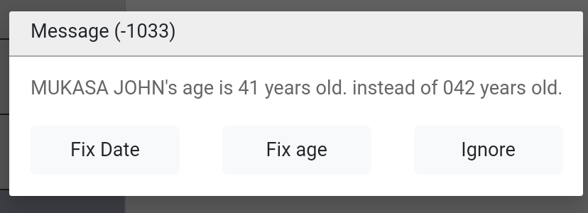
Error Messages
Warning message will allow to continue (note ‘W’ letter)
Error message requires correction before continuing (note ‘E’ letter)
Notes:
First type: The error provides buttons to return to two or more of the intervening questions that cause the error. It is a warning and by pressing “Continue” button, it allows to continue with the next applicable question.
Second type: The error provides buttons to return to two or more of the intervening questions that cause the error

Slide 14
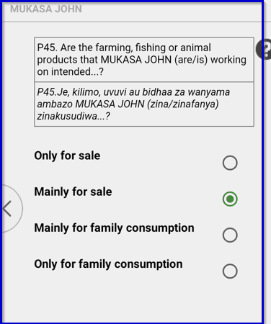
Changing interview language -Swahili Translation

Slide 15
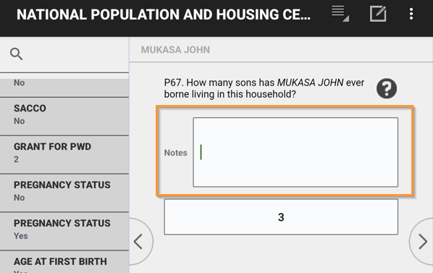
Taking Notes
Click on ‘Note’ icon at top of screen
Note will be associated with the current question
Type text to record note and then click “>” to continue

Slide 16
Partial Save of interview (1/4)
CAPI system automatically saves data at the end of each form/section
Sometimes interviewer may need to stop interview before it is completed and come back later.

Slide 17
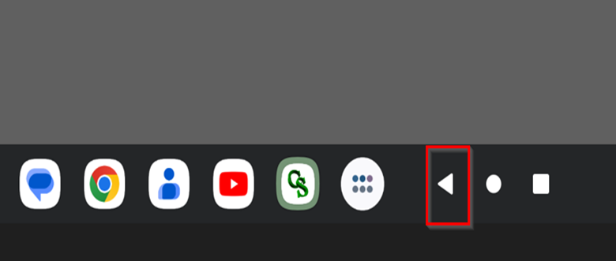
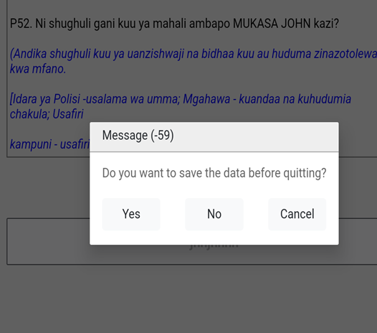
Steps for partial save of interview (2/4)
Method 1
Click on Android “Back” button at bottom left of screen. Note this is the Android back button not the CSPro button that moves back one field.
Notes:
To do so:
- Use Back Button menu to exit interview
- Select “Partial save” at prompt
Can also use “Save Partial” option from CAPI system menu to save all data entered, but this will not exit the interview
The Partially saved Household will display with an orange color.

Slide 18
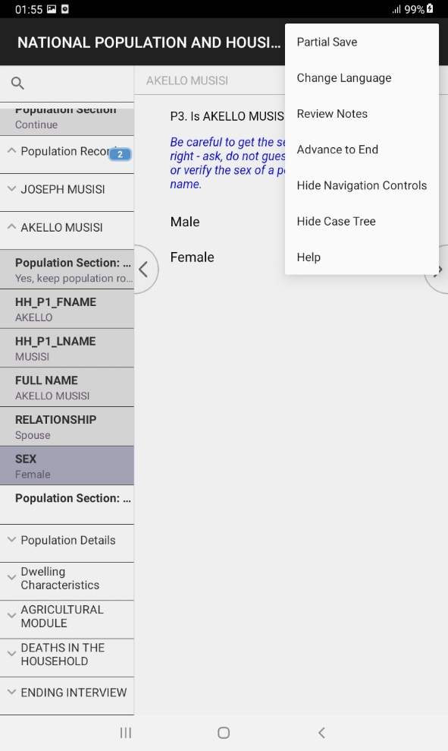
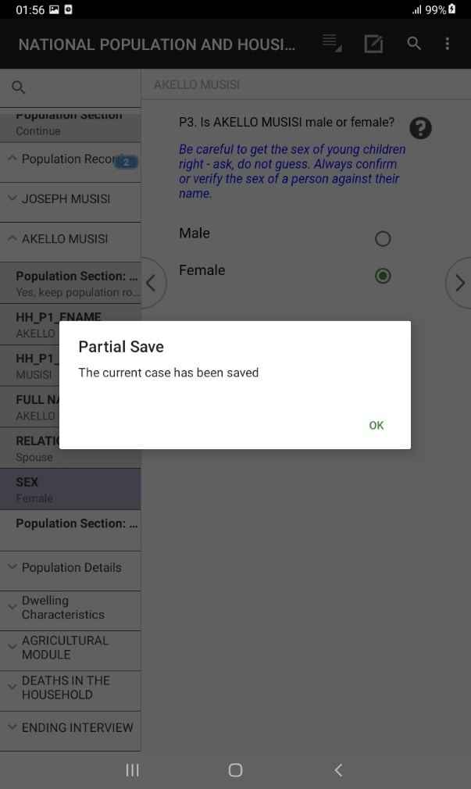
Steps for partial save of interview (3/4)
Method 2
Click on the 3 dots on the extreme right corner
Notes:
To do so:
- Use Back Button menu to exit interview
- Select “Partial save” at prompt
Can also use “Save Partial” option from CAPI system menu to save all data entered, but this will not exit the interview
The Partially saved Household will display with an orange color.

Slide 19
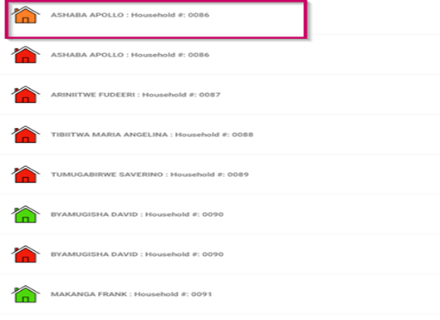
Partial save of interview (4/4)
Revisit partial Household: Go to Interviewer Menu select place to enumerate(View map) Swipe to display the list of all Household

Slide 20
Thank You
Any Questions

