Slide 1
Starting EA Household interviews using |CAPI
NPHC2024 TRAINING

Slide 2
What? When? Who? Where?
What? – Begin the EA household interview using CAPI menus
When? – After locating the household within the assigned EA
Who? – Interviewers/ Enumerators
Where?- In the household

Slide 3
Assignment Selection
Select EA to start work
Confirm that you are in the correct EA.

Slide 4
Household Enumeration
Notes:
Waiting on screenshot from Butambala

Slide 5
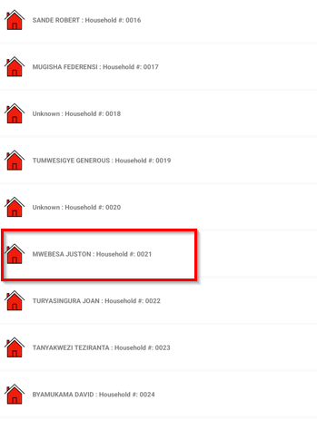
Selecting the Household to interview
All Households within the EA will populate
Tap/Click the household to begin with
All listed HHs during listing are automatically populated

Slide 6
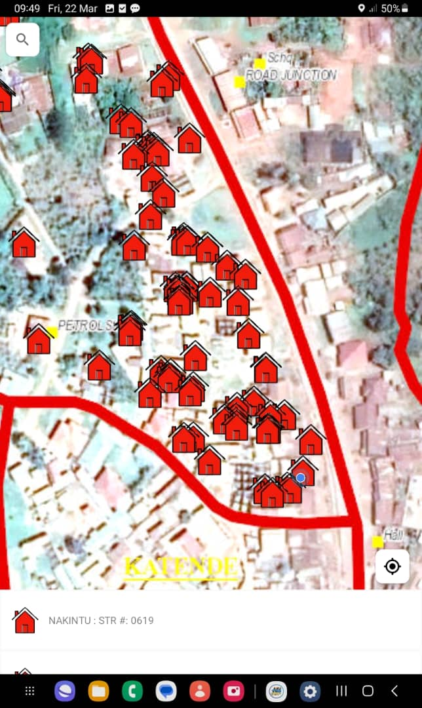
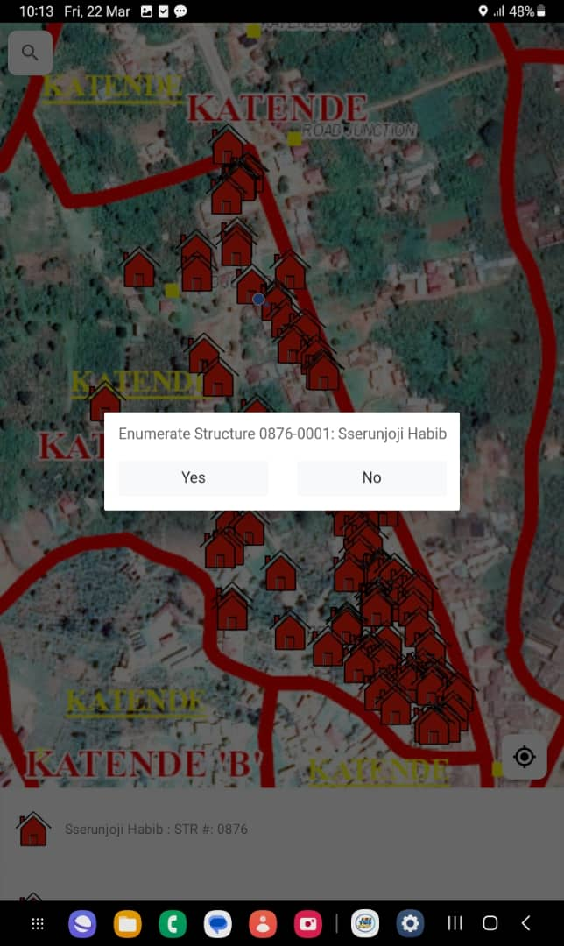
Selecting 2024 NPHC Household
Select Yes if that is the HH to interview

Slide 7
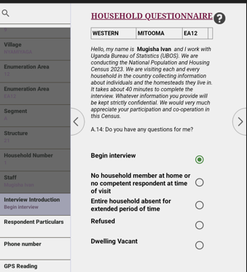
Begin a HH interview
Begin interview!

Slide 8
Begin HH interview
Geographical variables automatically populated
Date and time filled
Select 'Begin interview' to begin the interview
Read consent statement and enter result of consent

Slide 9
Begin with the population section
Begin with the population section. Select continue move to next questions

Slide 10
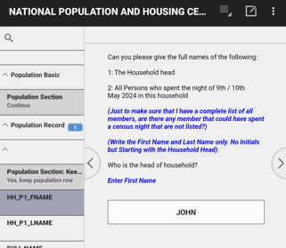
Begin HH interview
Start listing HH members starting with the HH head

Slide 11
Household listing asked in two parts
1. Names of household members
Repeats for each person in the household
Questions asked: First Name, Last Name, Relationship to HH head and sex

Slide 12
Household listing asked in two parts…
Add another HH member
No more HH member?
Notes:
Ask name, relationship and sex
At end of each set of questions there is a question “Are there any other persons living in this household?”
If answer is yes, there are additional persons, CAPI system will add an entry for another household member and repeat the set of questions

Slide 13
Particulars of HH members
2. Household Schedule – questions P4 – P87 repeated for each member.
Notes:
Insert a slide that shows the beginning of the house hold members particulars
Add a slide for the 4 modules of the HH questionnaire i.e. characteristics, agriculture, women, death

Slide 14
Begin Housing and Household Characteristics

Slide 15
Begin Agriculture section

Slide 16
Death in the Household section

Slide 17
Ending Interview

Slide 18
Exercise: Household questionnaire
Click the CSPro icon on your tablet screen
Select NATIONAL POPULATION AND HOUSING CENSUS 2024
Enter your Month, Year and telephone Number
Use the EA assigned to you and select the Household to begin with
Follow the mock interview and enter information carefully as it is given by the respondent.

Slide 19
Thank You
Any Questions

