Slide 1
FLOATING /HOMELESS PERSONS QUESTIONNAIRE
NPHC 2024 CENSUS TRAINING

Slide 2
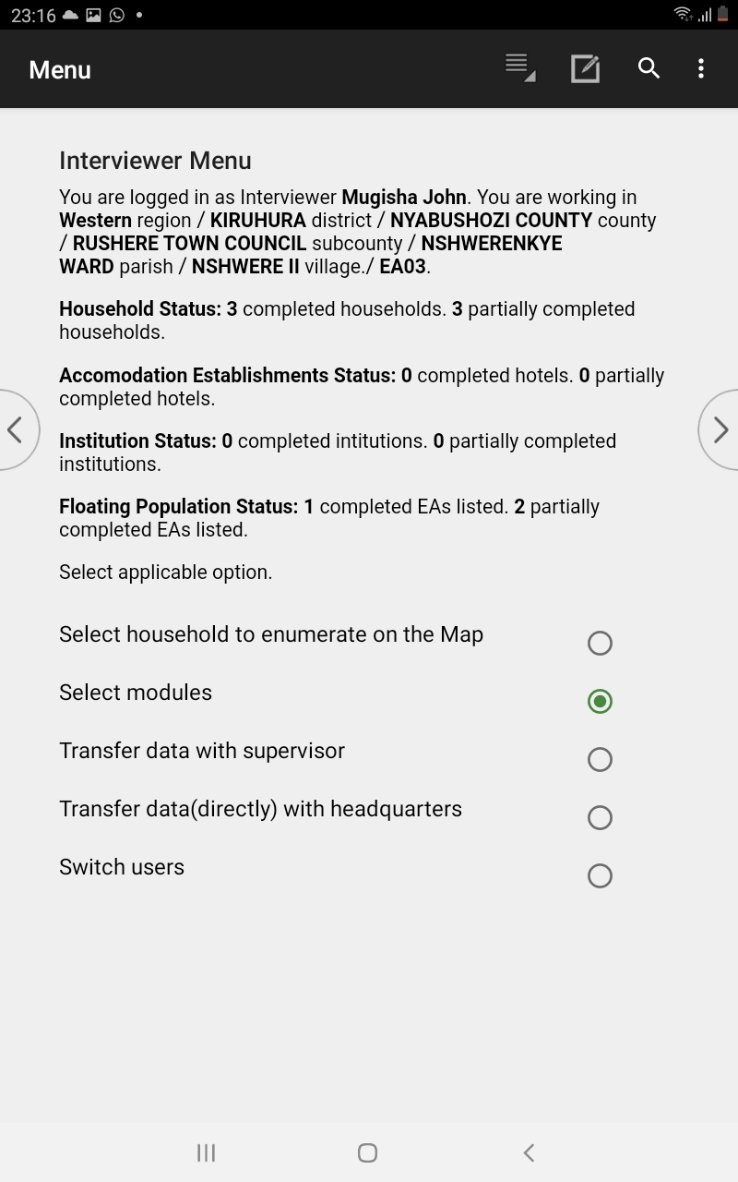
Floating/Homeless Persons Module
On the interviewer menu
select modules

Slide 3
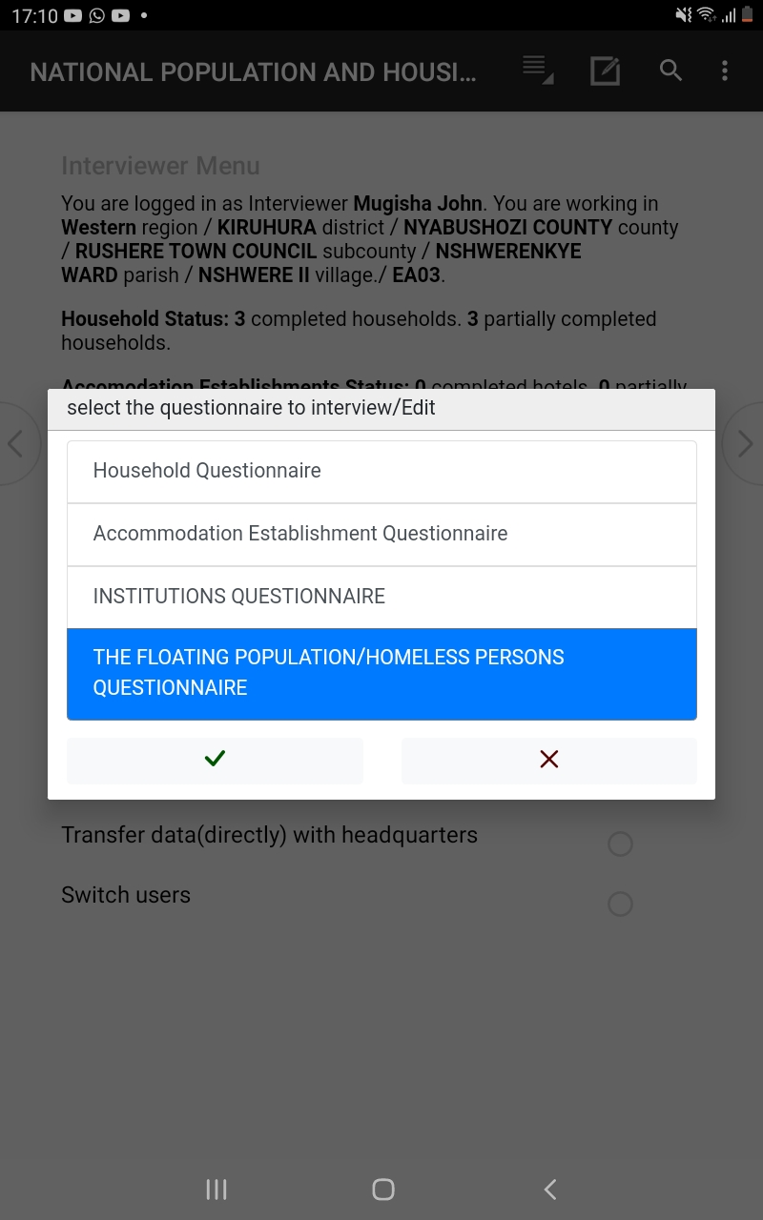
Floating/Homeless Persons Module…
Select the floating /homeless persons questionaire and then begin the interview

Slide 4
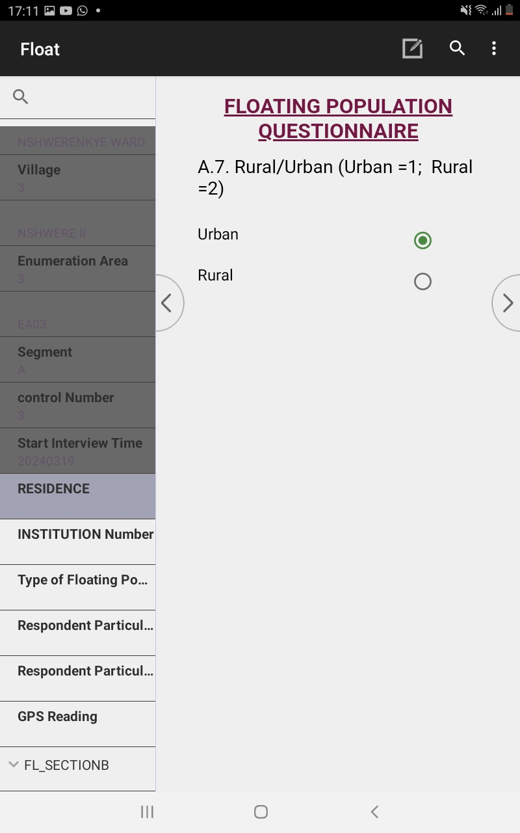
Floating/Homeless Persons Interview
The first screen of the floating population questionnaire

Slide 5
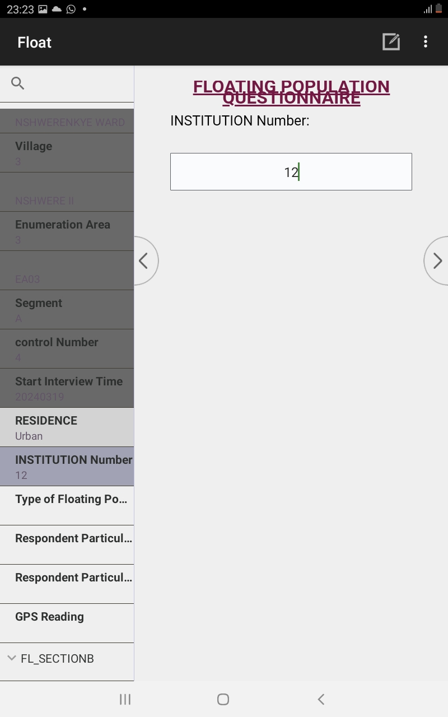
Floating/Homeless Persons Interview…
Insert the Floating population ID number

Slide 6
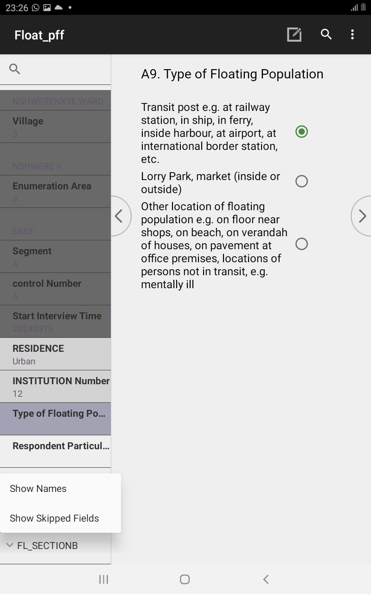
Floating/Homeless Persons Interview…
Select the type of floating population you are visiting to collect data

Slide 7
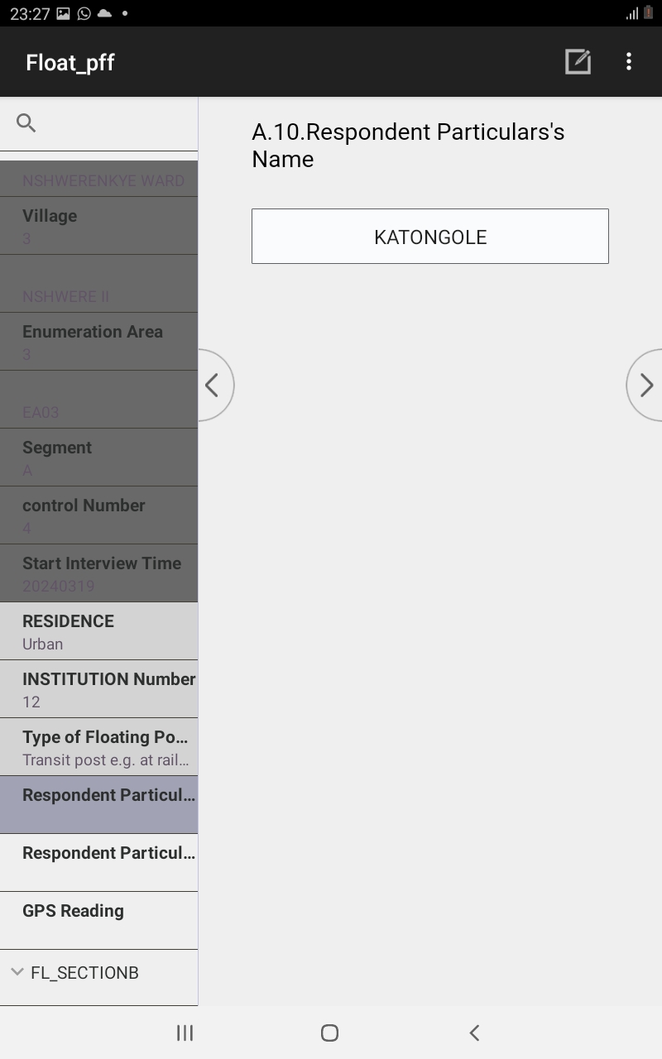
Floating/Homeless Persons Interview…
Then ask for the respondents Name who is giving you information

Slide 8
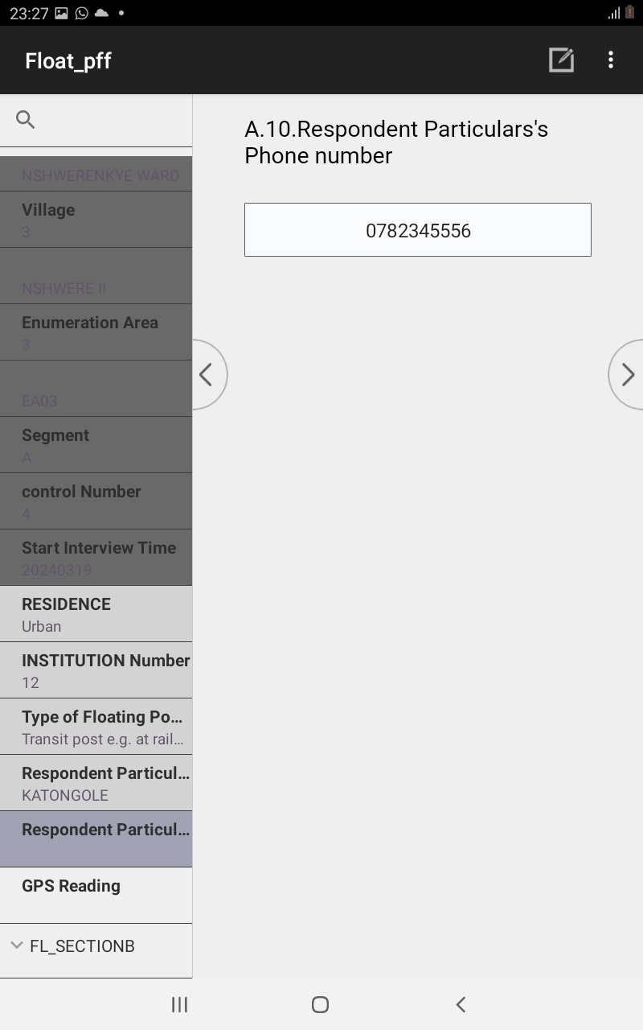
Floating/Homeless Persons Interview…
Then ask for the respondents Phone number

Slide 9
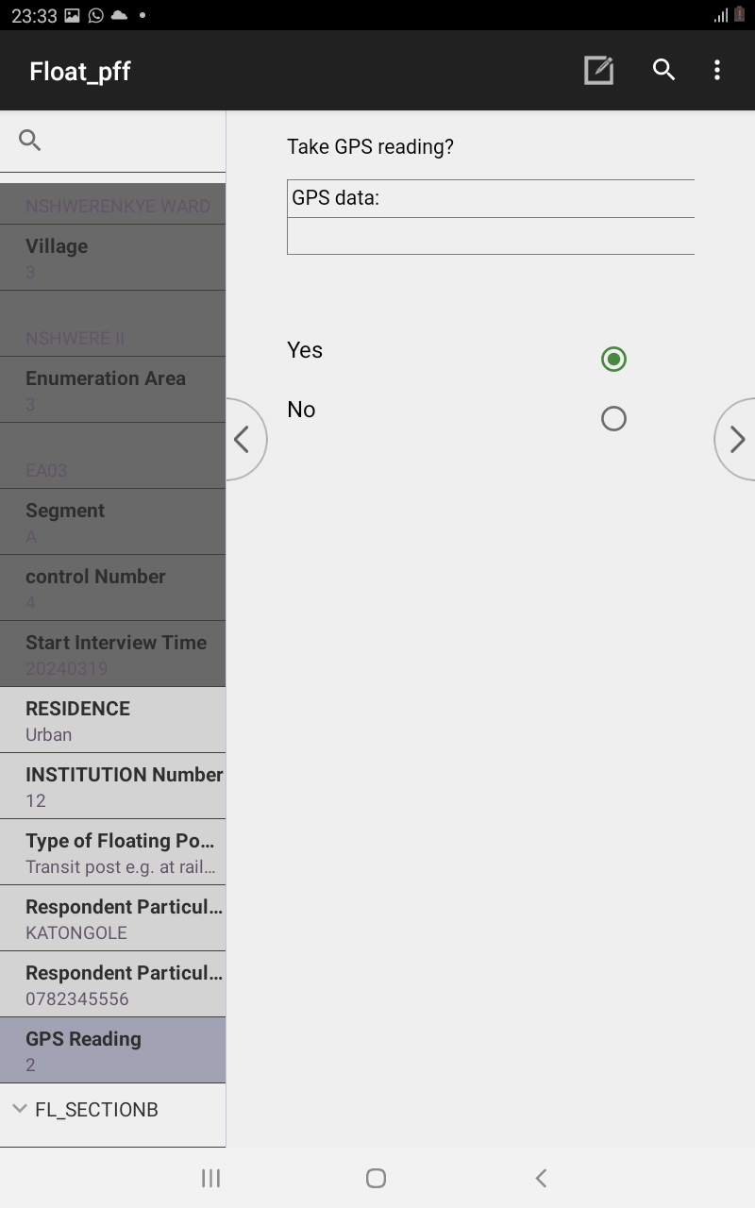
Floating/Homeless Persons Interview…
Then Pick the GPS coordinates of the location your conducting interviews from

Slide 10
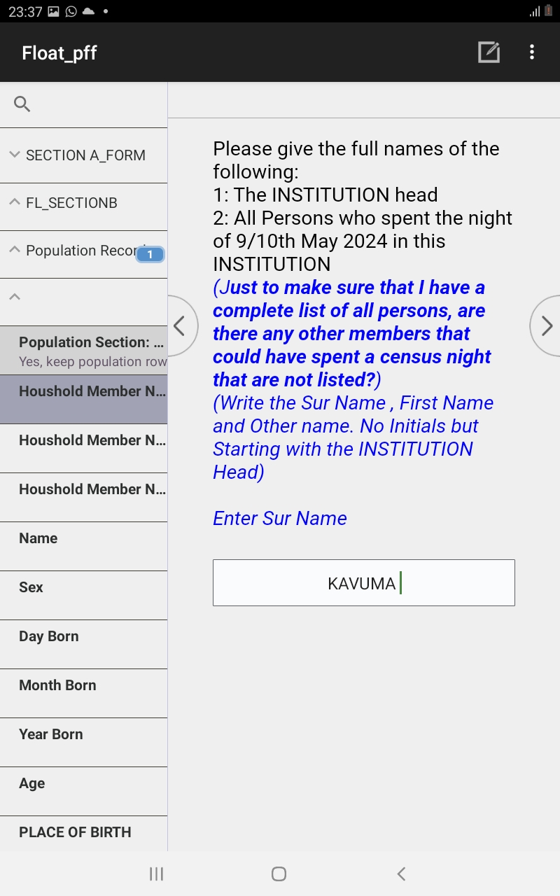
Floating/Homeless Persons Interview…
The ask for the names of the respondents starting with the surname

Slide 11
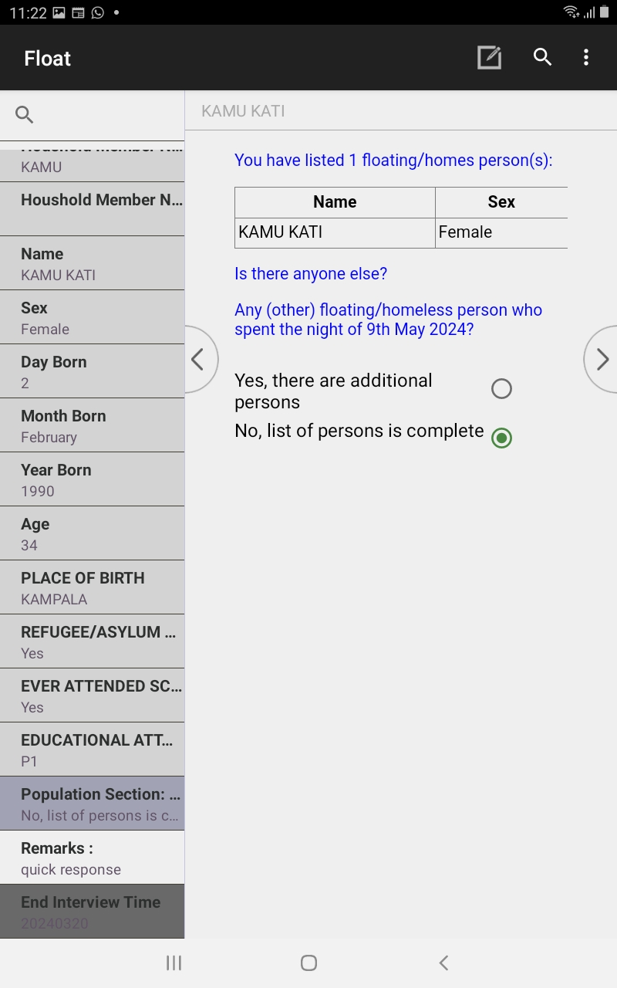
Floating/Homeless Persons Interview…
Select yes if there are additional people to interview and no if the list of persons is complete

Slide 12
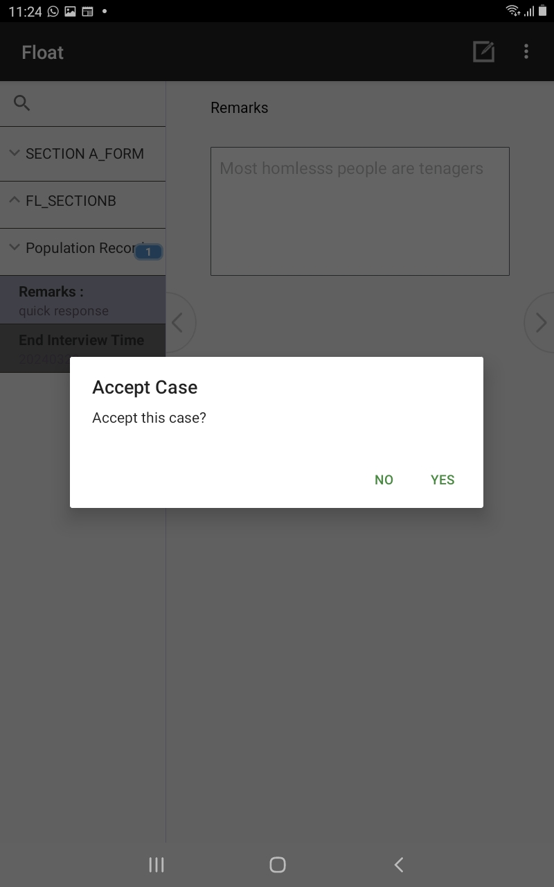
Floating/Homeless Persons Interview…
End the interview ,Select yes and save

Slide 13
Thank You
Any Questions

